Slide 1




Smart installation policy
Go live – December 1st 2025
SPERL – 04625 – 009

Slide 2
Smart installation policy
This document details the ScottishPower Policy regarding the installation of Smart metering as amended from time to time. This policy describes the principles and guidelines to be adopted by Meter Installers who are operating on behalf of ScottishPower.
We’re not aiming for 100% commissioned — just 100% policy compliance, so remember: any non-COMP-FULL scenario must be escalated to Smart Support.

Slide 3
Smart installation policy
Policy Update – Key Message
This PowerPoint covers the latest changes to the installation policy.
Expectation remains the same: Any scenario without COMP-FULL must be escalated to the Smart Support Team.
The updated policy significantly benefits SESM and increases the number of meters the field can confidently leave on the wall.
Non-adherence will be monitored, and any examples identified will be shared with management for prompt review

Slide 4
Smart installation policy
1 – Site attendance Job Attendance
Scheduled jobs are sent to the Engineer’s HHT with a defined date and time slot.
If cancelled or aborted before arrival, the Engineer closes the job as per company policy; otherwise, the Engineer attends site.
On-Site Procedure
Perform a dynamic risk assessment before starting any work.
Confirm correct premises, identify meter locations, and assess dual-band suitability.
If the Meter Serial Number differs from job details, record the correct MSN and continue.
Meter Readings
If the meter has no visible display, the existing meter reading field must be updated with ‘0’ (zero).
For return assets, refer to section 15.
Failed Smart Commissioning
When a smart meter is installed but commissioning fails, the customer must be issued a "Sorry we couldn't complete" leave-behind card (SCP8632-JUL25).
We’re not aiming for 100% commissioned — just 100% policy compliance, so remember: any non-COMP-FULL scenario must be escalated to Smart Support.

Slide 5
Smart installation policy
2 – Dual Band consideration Before installing any smart assets, the Engineer must assess the service position and locations of CH, ESME, GSME, and PPMID.
If any device is over 7 meters from the CH, or less if obstructed by physical infrastructure, Dual Band (DB) assets must be installed.
Distance Requirements
If any device is more than 20 meters from the CH and unlikely to connect, a Dual Band Cellular CH must be installed.
Existing Equipment
If a Single Band CH is present and DB equipment is now required (GSME/PPMID), the CH must be replaced with a Dual Band unit.
We’re not aiming for 100% commissioned — just 100% policy compliance, so remember: any non-COMP-FULL scenario must be escalated to Smart Support.

Slide 6
Smart installation policy
3 – Communications Hub selection
All smart installs must have a communication hub
D
Please note: As stock positions improve, more work will shift to 4G including single phase single rate CR
CSP | Job Type | ‘Initial’ CH Type | ‘WAN or Join Fail’ CH Type | Abort
North | Single Phase – Single Rate CR | 420 | 420 | No
 | Sigle Phase – Single Rate PP | 420 | 4G | No
 | Single Phase – Multi Rate CR & PP | 420/450 | 4G | No
 | Three Phase – Single Rate CR & PP | 420/450 | 4G | No
 | Three Phase – Multi Rate CR & PP | 420/450 | 4G | Yes
Central & South | Single Phase – Single Rate CR & PP | 2/3/4G | 2/3/4G | No
 | Single Phase – Multi Rate CR & PP | 2/3/4G | 2/3/4G | No
 | Three Phase – Single Rate CR & PP | 2/3/4G | 2/3/4G | No
 | Three Phase – Multi Rate CR & PP | 2/3/4G | 2/3/4G | Yes
We’re not aiming for 100% commissioned — just 100% policy compliance, so remember: any non-COMP-FULL scenario must be escalated to Smart Support.

Slide 7
Smart installation policy
4 - Smart Meter Installation Requirements
All smart jobs require a smart meter and must include a Communications Hub (CH).
Newly installed meters must not be swapped unless believed to be faulty, unless otherwise instructed by SESM smart support or by the SP Field Support Team.
Faulty Device Removal
Removal of any newly installed faulty device must be approved by the MOA Support Team
Job Type | Meter Type | IL / IJL
Single Rate 1ph | 4T SMART | Yes
Multi Rate 1ph | 5T SMART | Yes
Single Rate 3ph | 3ph SMART | Yes
Multi Rate 3ph | 3ph SMART | No
Gas | SMART | Yes
Smart to Smart | SMART | Yes

Slide 8
Smart installation policy
5 – WAN
Before executing the ‘HHT Start’ process, it is expected that the Engineer will consider the CH LED sequence. Where the LED indicates No WAN, the Engineer should follow the process in the table below.
 | No WAN – 420 / 450 CH |  | No WAN – 4G CH
1. 2. 3. | Incorrect WAN LED status - Power cycle the CH with a minimum 10 second power down time. Incorrect WAN LED status - Swap the CH for 4G. Incorrect WAN LED status - Follow 4G guidance. | 1. 2. 3. | Incorrect WAN LED status - Power cycle the CH with a minimum 5-minute power down time. Incorrect WAN LED status - Replace 4G CH with another 4G CH. Incorrect WAN LED status - Install and Leave for all eligible installs. For noneligible installs refit the legacy metering.
 | No WAN – 2/3G CH
1. | Incorrect WAN LED status - Power cycle the CH with a minimum 3-minute power down time.
2. | Incorrect WAN LED status - Replace SKU1 CH with another SKU1 CH if applicable.
3. | Incorrect WAN LED status - Replace SKU1 CH with SKU2 + T2 aerial.
4. | Incorrect WAN LED status - Install and Leave for all eligible installs. For non-eligible installs refit the legacy metering.
We’re not aiming for 100% commissioned — just 100% policy compliance, so remember: any non-COMP-FULL scenario must be escalated to Smart Support.

Slide 9
Smart installation policy
6 – HHT submission
All smart installs require a valid HHT Start submission.
Submitting Assets
Each asset should be submitted as a standalone “HHT Start Initial” message to Meterflow.
The Engineer must wait for a COMP FULL message before proceeding to the next asset.
If commissioning errors occur, refer to SESM smart support
Exception – 1 Rate Credit Jobs
For standard single-rate credit work with no PP or ALCS, all assets may be submitted within a single HHT submission.
If unsure, the Engineer must contact SESM smart support
We’re not aiming for 100% commissioned — just 100% policy compliance, so remember: any non-COMP-FULL scenario must be escalated to Smart Support.

Slide 10
Smart installation policy
7 – PPMID
PPMID Offer & Installation
All domestic customers must be offered a PPMID.
It must be joined to the CH in a suitable location agreed with the customer.
If distance or obstacles require it, install DB PPMID and/or DBCH.
Credit Customers
Engineers should advise credit customers of the benefits of the ScottishPower App as an alternative to a PPMID.
Prepayment Customers
Engineers must input the initial UTRN on the PPMID where applicable.
Customer Messaging – PPMID Failure
If PPMID fails but SMETS2 meters are commissioned:
We have successfully fitted your new smart meter(s) but unfortunately the PPMID has failed to fully join the communications network. Please leave your PPMID switched on and in range of the communications hub and it should successfully finish the set-up process in the next 48 hours. If in the rare event that the PPMID doesn’t successfully set up it is still possible to view your usage data on the Scottish Power app.
Additional Messaging – Prepayment Customers You will be able to top up through the Scottish Power App, at the registered shops or through entering the UTRN as demonstrated. The meters will display your usage/credit balance on their screens (engineer to show customer the meter screens) in the same way as your old traditional meters, as well as this information being available through the Scottish Power app. Once your PPMID is fully functioning it will also show this information.
We’re not aiming for 100% commissioned — just 100% policy compliance, so remember: any non-COMP-FULL scenario must be escalated to Smart Support.

Slide 11
Smart installation policy
8 & 9 – Install & leave / Install, Join & Leave
Install & Leave
Designed for situations where assets cannot be joined on site due to:
No WAN coverage
System outages
Error messages listed in Error Handling
Allows the Engineer to install devices and leave the site, with assets remaining un-joined until network/service recovery.
Applies only to eligible job types as defined in policy.
Install, Join & Leave
Designed to reduce on-site time for eligible jobs.
Process:
Confirm WAN via CH LED activity.
Join devices to the HAN and verify join status on each device.
HAN join must be evidenced with a photograph for validation.
Once WAN and HAN are established and devices are joined:
The remaining service requests continue automatically via the CH. AS A REMINDER, IN ANY SCENARIO WHERE COMP-FULL IS NOT RECEIVED, THE ENGINEER MUST CONTACT SESM SMART SUPPORT PRIOR TO LEAVING SITE.
We’re not aiming for 100% commissioned — just 100% policy compliance, so remember: any non-COMP-FULL scenario must be escalated to Smart Support.

Slide 12
Smart installation policy
10. Job Type Specific Instructions
10.1 Multi-Rate
Commissioning should always be completed at install to ensure the off-peak calendar is correctly loaded.
Single-phase multi-rate jobs:
Eligible for Install & Leave (I&L) and Install, Join & Leave (IJ&L) if commissioning fails.
Exceptions: ECO2000 and THTC configurations (not eligible).
Three-phase multi-rate jobs:
Not in scope for I&L / IJ&L.
Refer to Section 11.2 – Drop Fuel.
10.2 Prepayment
If the removing meter display is blank, record the meter balance as £0.00.
After installing the new meter, a balance of £30.00 will automatically appear.
If the old meter shows a balance >£30.00 and ≤£255.00, record the value — this will be transferred to the new meter.
If the balance is >£255.00:
Record the full value.
Only £30.00 transfers to the new meter.
Customer must be advised to contact ScottishPower for refund of the remaining credit.
Where UTRNs are delivered to the HHT, the Engineer must demonstrate how to input them to the customer.
We’re not aiming for 100% commissioned — just 100% policy compliance, so remember: any non-COMP-FULL scenario must be escalated to Smart Support.

Slide 13
Smart installation policy
10. Job Type Specific Instructions
10.3 ECO Jobs – General Requirements
All ECO jobs must be completed using a smart meter and communications hub.
SP policy requires that customers are not left vulnerable (no supply / no heating / no hot water).
If the Engineer cannot replace equipment due to lack of stock, this must be escalated to the Line Manager for support.
Gas ECO – Hot Shoe Requirements
A Hot Shoe must be installed unless one of the following applies:
No live electric supply → Install & Leave
No access to the electricity service position → Install & Leave with photographic evidence
Inadequate space for the Hot Shoe → Install & Leave with photographic evidence
Customer Refusal to Power Down
There is no agreement allowing customer refusal to power down when a Hot Shoe is required.
If the customer refuses to power down, the Engineer must escalate to Dispatch/OOH.
Only the three reasons listed above are valid grounds for not installing a Hot Shoe on emergency jobs.

Slide 14
Smart installation policy
10. Job Type Specific Instructions
10.5 Gas Solus (excluding New Connections)
All Gas Solus jobs must be completed with a smart meter and communications hub.
For No WAN, refer to Section 4 – WAN.
If a Dual Band CH is required, follow Section 2 – Dual Band Consideration.
10.6 New Connections
All New Connections must be serviced with a smart meter and communications hub.
For No WAN, refer to Section 4 – WAN.
Dual Band Requirements
If a Dual Band CH is required based on device distance, see Section 2.
If the DB GSME fails to join, the Install & Leave process must be followed.
Where a Gas New Connection is outside DB range, the Engineer must Install & Leave.
Hot Shoe Requirements (Gas New Connections) Install & Leave must be used when the job requires a Hot Shoe but:
No live electric supply
No access to the electricity service position
Photographic evidence required
Inadequate space for the Hot Shoe
Photographic evidence required
We’re not aiming for 100% commissioned — just 100% policy compliance, so remember: any non-COMP-FULL scenario must be escalated to Smart Support.

Slide 15
Smart installation policy
11. Aborts after HHT submission (Drop Fuel) If an engineer aborts installation of any smart asset(s), they must update Meterflow to reflect the true site condition
When a smart asset has been loaded via HHT but is not installed or later removed, the HHT Drop Fuel action must be performed
We’re not aiming for 100% commissioned — just 100% policy compliance, so remember: any non-COMP-FULL scenario must be escalated to Smart Support.

Slide 16
Smart installation policy
12. HAN HAN – Home Area Network
Engineer must consider use of:
DB CH, DB GSME, and/or DB PPMID
If a device fails to join HAN, the Engineer receives an Alert Response via HHT and must action alerts following SESM Smart Support team guidance
Always escalate non-COMP-FULL scenarios to Smart Support

Slide 17
Smart installation policy
12. HAN HAN – Home Area Network
Engineer must consider use of:
DB CH, DB GSME, and/or DB PPMID
If a device fails to join HAN, the Engineer receives an Alert Response via HHT and must action alerts following SESM Smart Support team guidance
We’re not aiming for 100% commissioned — just 100% policy compliance, so remember: any non-COMP-FULL scenario must be escalated to Smart Support.

Slide 18
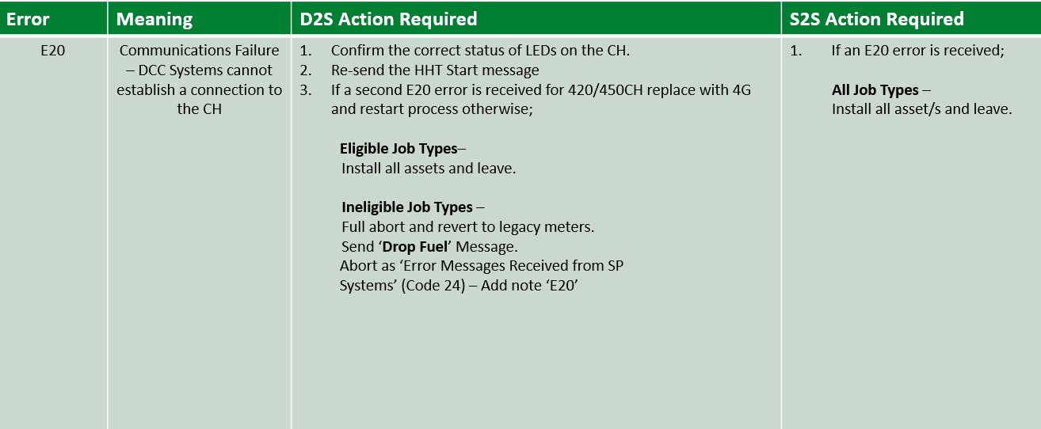
Smart installation policy
Error handling E20
We’re not aiming for 100% commissioned — just 100% policy compliance, so remember: any non-COMP-FULL scenario must be escalated to Smart Support.

Slide 19
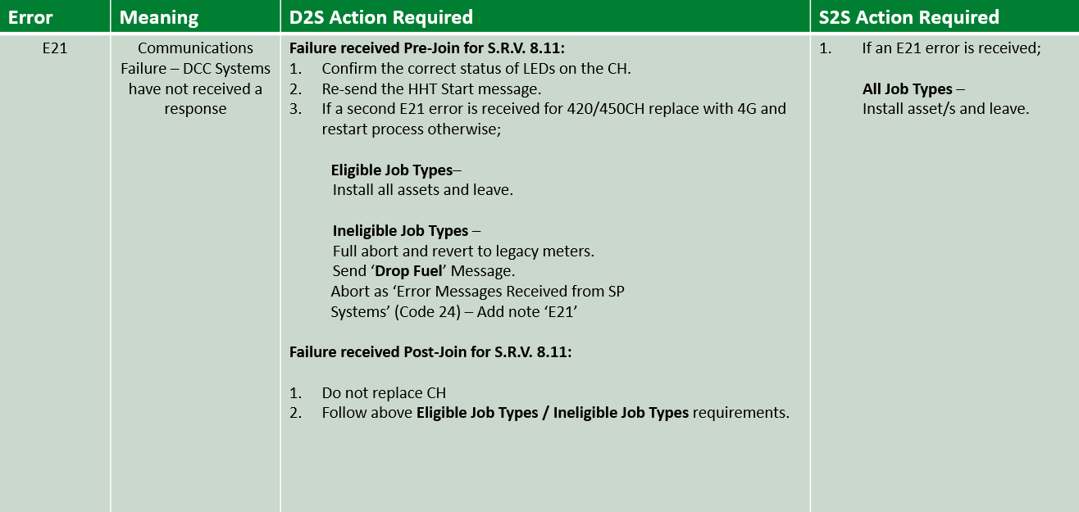
Smart installation policy
Error handling E21

Slide 20
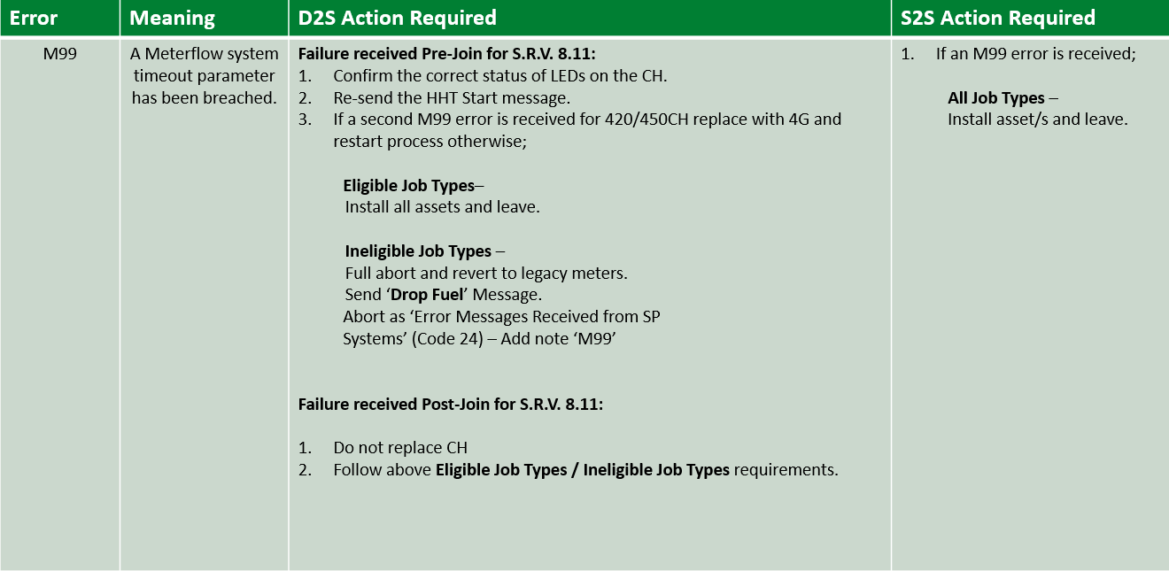
Smart installation policy
Error handling M99

Slide 21
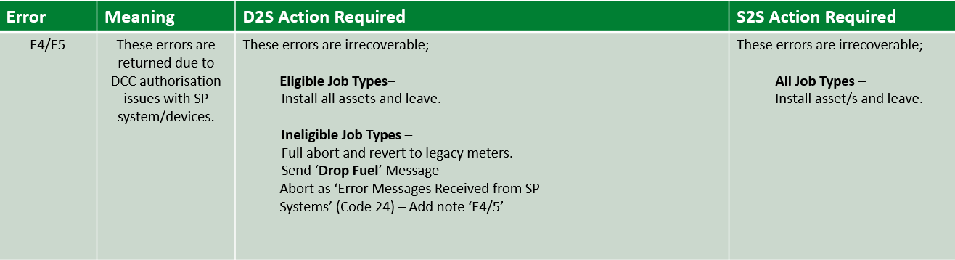
Smart installation policy
Error handling E4 & E5
We’re not aiming for 100% commissioned — just 100% policy compliance, so remember: any non-COMP-FULL scenario must be escalated to Smart Support.

Slide 22
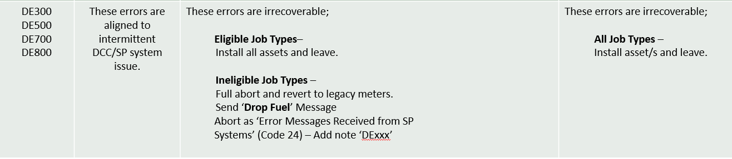
Smart installation policy
Error handling DExxx
We’re not aiming for 100% commissioned — just 100% policy compliance, so remember: any non-COMP-FULL scenario must be escalated to Smart Support.

Slide 23
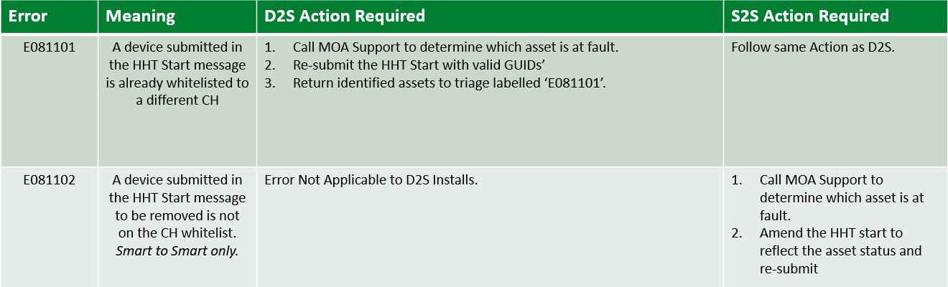
Smart installation policy
Error handling E081101 & E081102
We’re not aiming for 100% commissioned — just 100% policy compliance, so remember: any non-COMP-FULL scenario must be escalated to Smart Support.

Slide 24
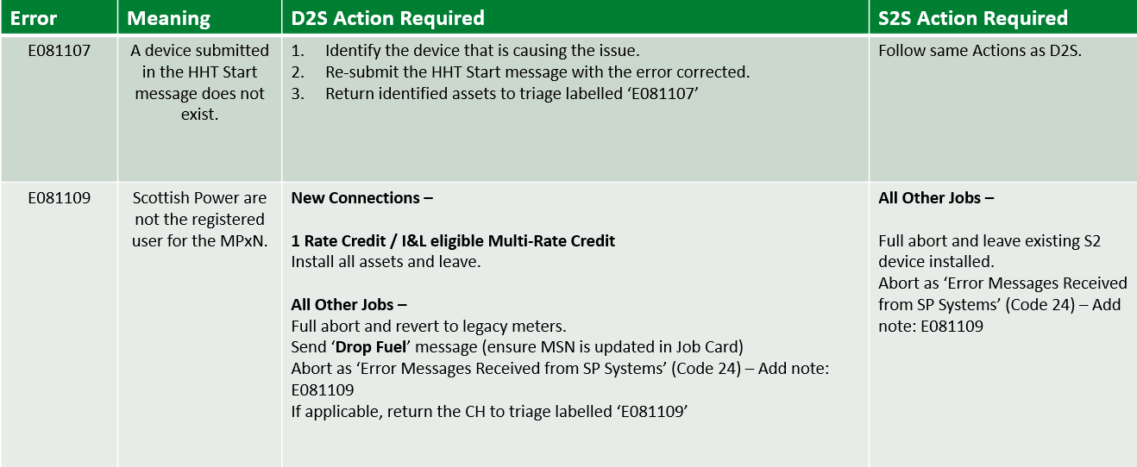
Smart installation policy
Error handling E081107 & E081109
Always escalate non-COMP-FULL scenarios to Smart Support

Slide 25
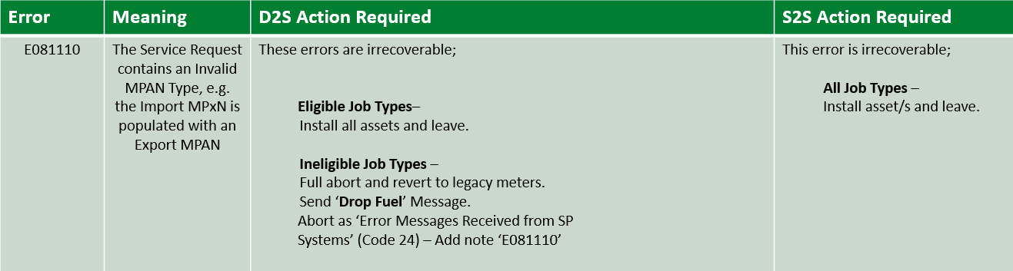
Smart installation policy
Error handling E081110
We’re not aiming for 100% commissioned — just 100% policy compliance, so remember: any non-COMP-FULL scenario must be escalated to Smart Support.

Slide 26
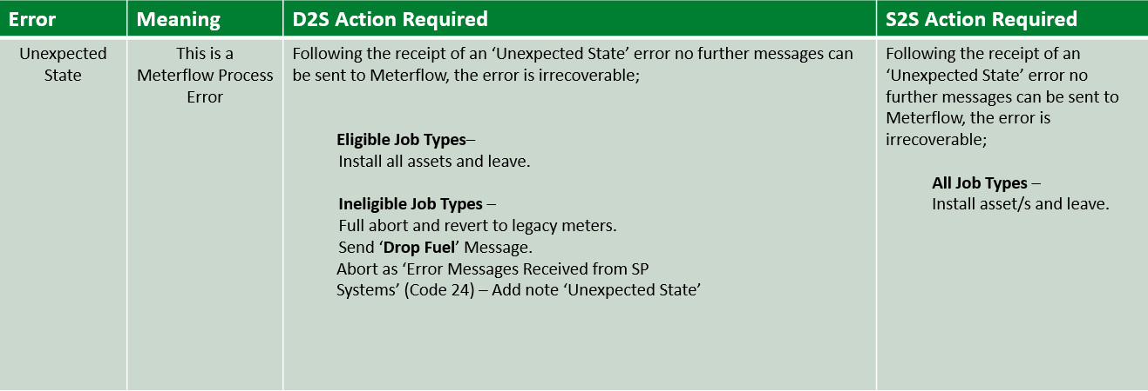
Smart installation policy
Error handling Unexpected state
We’re not aiming for 100% commissioned — just 100% policy compliance, so remember: any non-COMP-FULL scenario must be escalated to Smart Support.

Slide 27
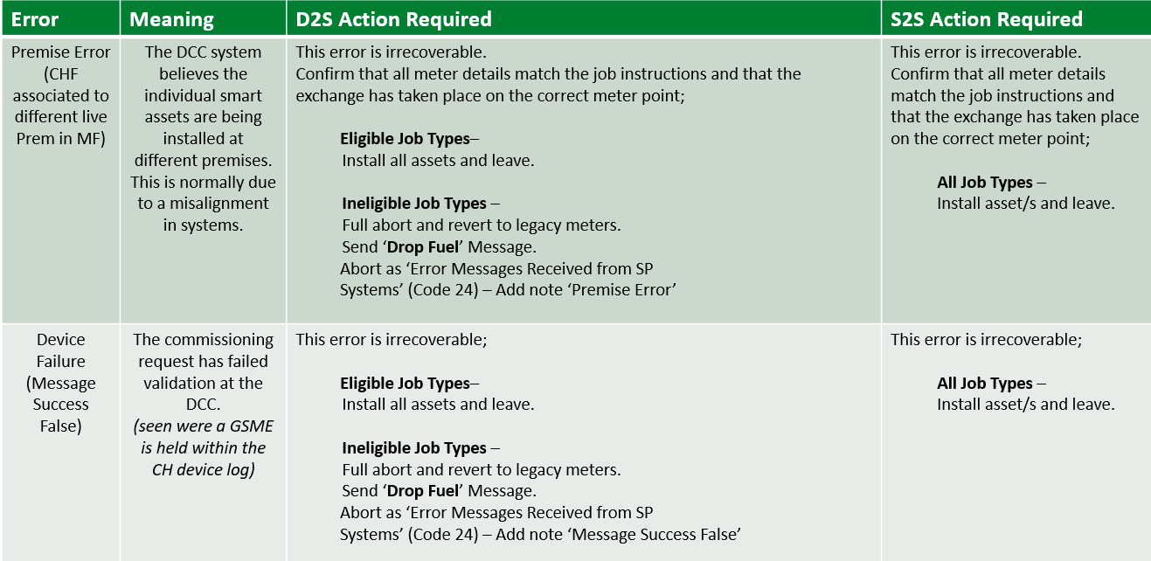
Smart installation policy
Error handling

Slide 28
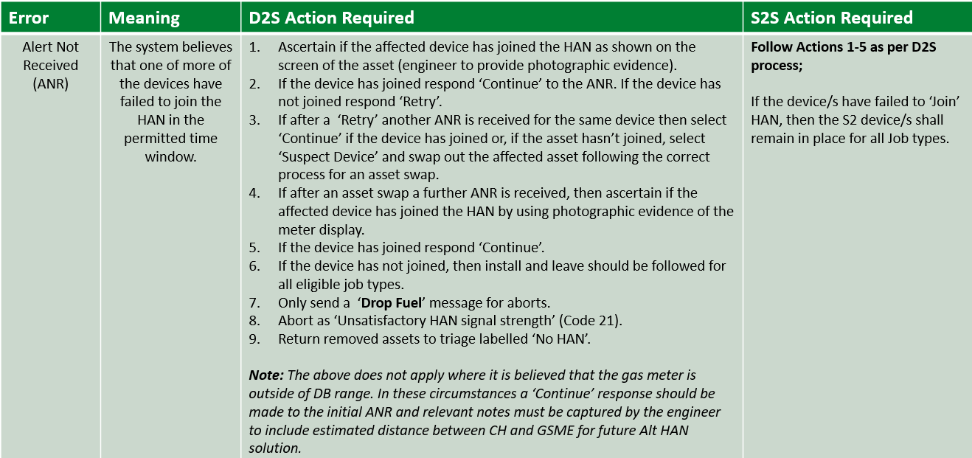
Smart installation policy
Error handling ANR

Slide 29
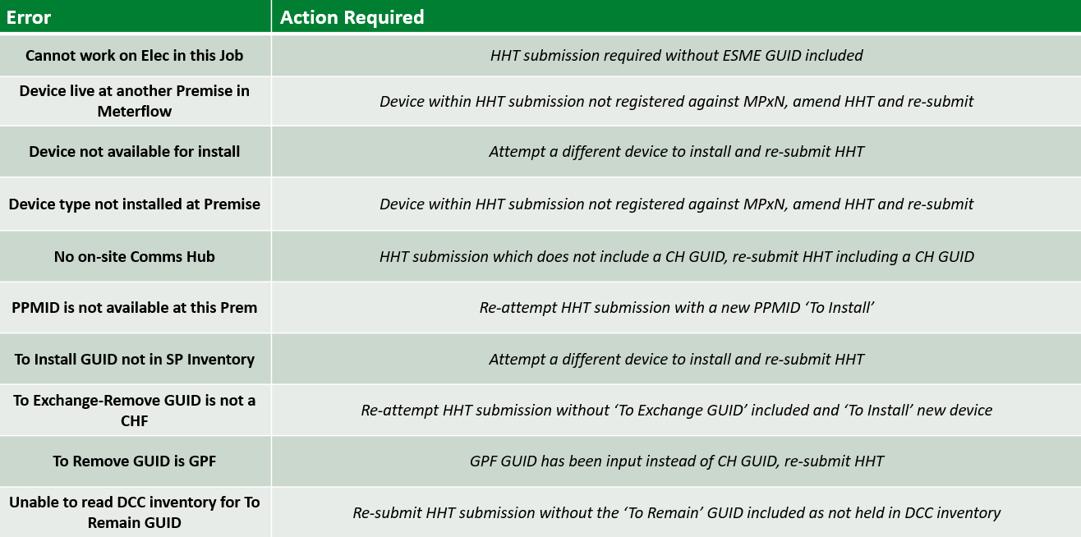
Smart installation policy
Error handling HHT Validation

